Slide 1
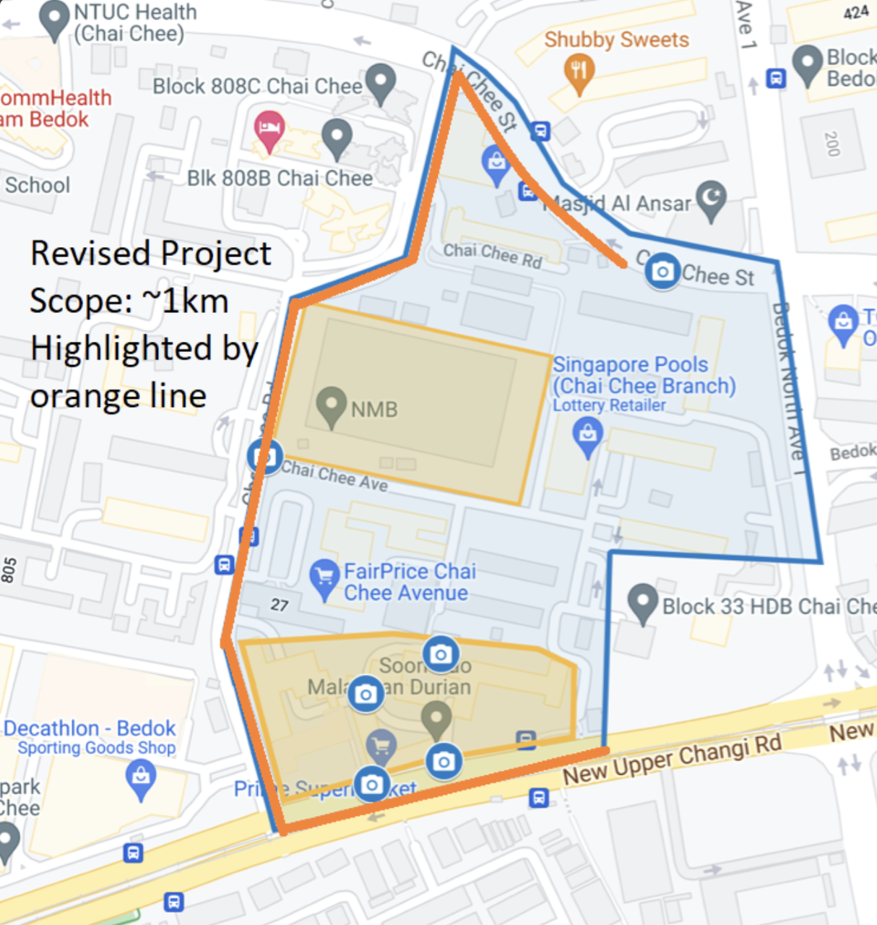
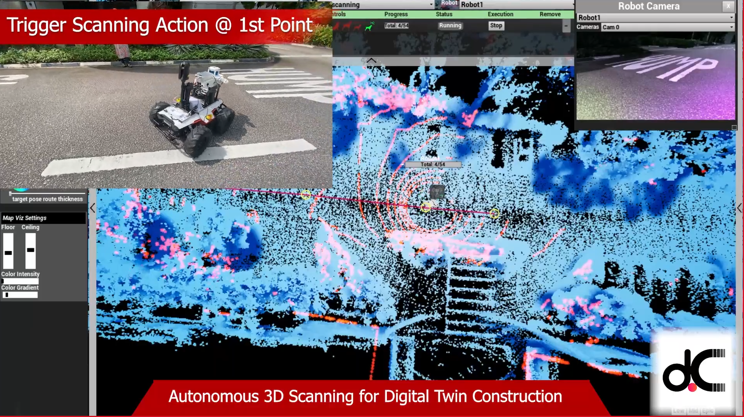
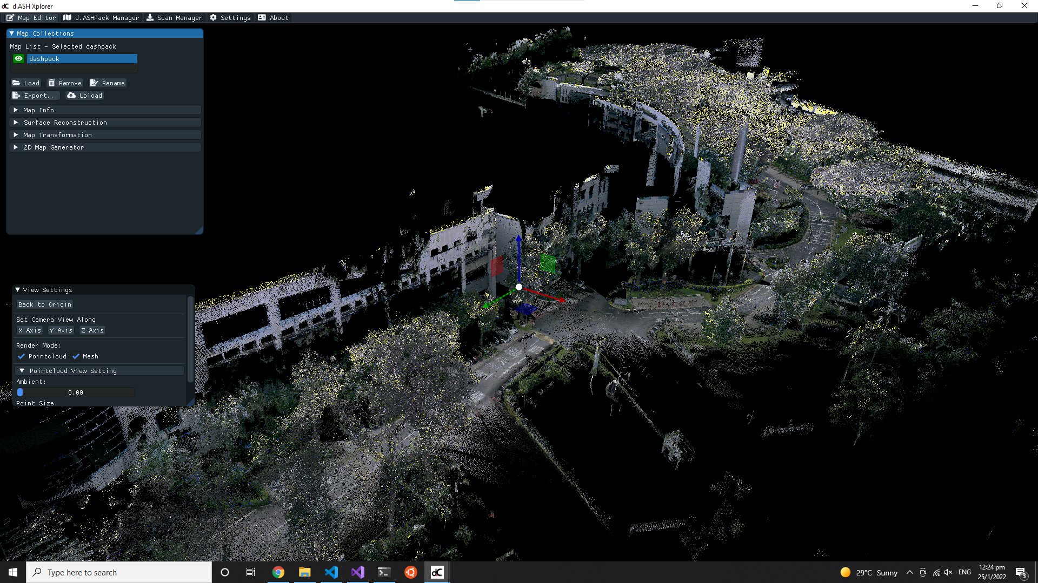
KPI | Improve accuracy and time efficiency for 3D scene reconstruction | CHALLENGE STATEMENTS: Remove the need for manual scanning of real life environments Incorporate automation in the data capturing process Introduce automated robots into unstructured outdoor environments
PROCESS | CONVENTIONAL PROCESS: Scanning of environments are done in small batches which takes days to complete and render on a software
 | NEW PROCESS: An autonomous robot will be deployed around the desired area to be scanned. It will automatically capture all required 3D environmental data along its scanned route. Data is then automatically merged and stitched together to produce an accurate 3D reconstruction of the site
INFORMATION | Automatic data transfer from d.ASH Pack and d.ASH Xplorer enables seamless data integration between our products
TECHNOLOGY | Map data is exported in industry-standard file formats (pcd, xyz, laz, e57, ply) that are compatible with any major visualization and modelling software
dConstruct Technologies
hello@dconstruct.group
+65 6100 5328
10 Central Exchange Green #03-01 PIXEL Singapore 138649
Manual stitching and editing of the collected data
~3 days per km
Data collection on site
~3 days per km
START
END
Total time required: approx. 1 week per km
Plan route to scan
~15 mins
Deploy robot on site and activate autonomous remote scanning for data capture
~5 hours
Transfer data to d.ASH Xplorer to automatically stitch and merge the 3D data
~1 hour
START
END
Total time taken: approx. 6.5 hours (Customer: Singapore Institute of Technology) (Project: SIT-LTA Ground Scanning at Bedok)
Rapid map turnaround time with scale consistency leads to faster and more effective deployment of robots
3D reconstruction from d.ASH Xplorer
compatible
with
Autodesk Software (Revit, AutoCAD)

